Slide 1
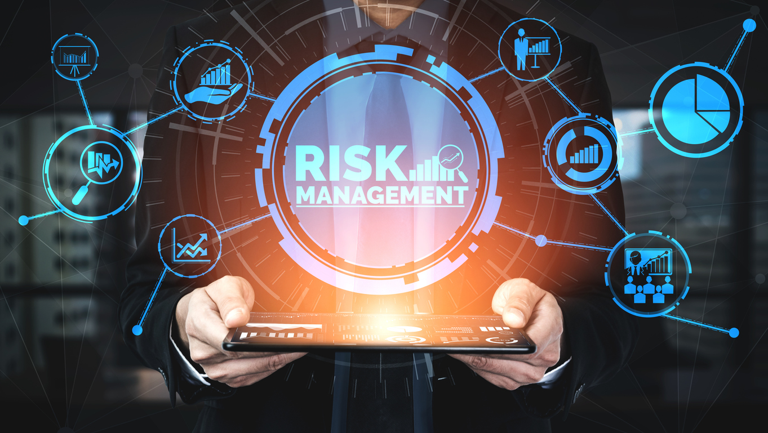
T. ADITYA SATYA SRI HARI
192110559
MD.TAUFEEQ HUSSAIN
192110727

Slide 2
CONTENT
Abstract
What is risk ?
Structure of risk management
Response to risk management
Importance of risk management
Risk analysis
Embodies of risk management
Principles of risk management
Risk management paradigm
Literature review
Suggestions
Conclusion
Reference

Slide 3
ABSTRACT
Effective risk management contributes to the success of the software development project. The goal of this work was to identify risk management gaps, perspectives, the evolution of the theme and the study trends, in software development projects, using systematic literature review as a method.
For the biometric analysis, articles referring to the topic were selected in the period from 2010 to 2018. As tools of analysis, Citespace and VOS Viewer software were used, allowing a comparative evaluation between the articles, as well as the analysis of clusters.

Slide 4
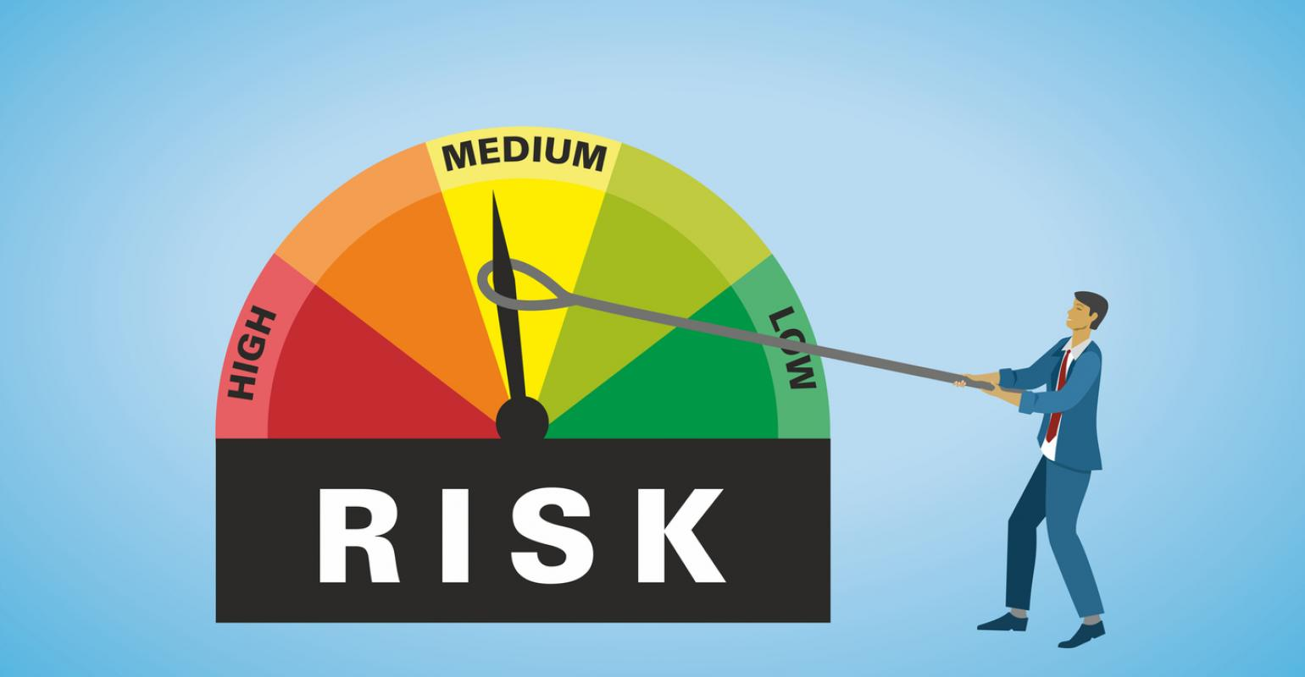
WHAT IS RISK ?
Risk management is the process of identifying, assessing and controlling threats to an organization's capital and earnings.
These risks stem from a variety of sources including financial uncertainties, legal liabilities, technology issues, strategic management errors, accidents and natural disasters.

Slide 5
STRUCTURES OF RISK MANAGEMENT
Risk management structures are tailored to do more than just point out existing risks. A good risk management structure should also calculate the uncertainties and predict their influence on a business.
Consequently, the result is a choice between accepting risks or rejecting them. Acceptance or rejection of risks is dependent on the tolerance levels that a business has already defined for itself.

Slide 6
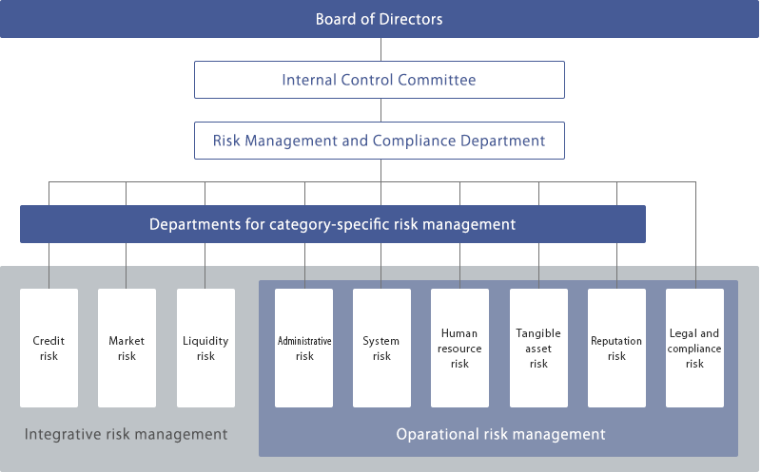

Slide 7
RESPONSE TO RISKS
Response to risks usually takes one of the following forms:
Avoidance: A business strives to eliminate a particular risk by getting rid of its cause.
Mitigation: Decreasing the projected financial value associated with a risk by lowering the possibility of the occurrence of the risk.
Acceptance: In some cases, a business may be forced to accept a risk. This option is possible if a business entity develops contingencies to mitigate the impact of the risk, should it occur.

Slide 8
IMPORTANCE OF RISK MANAGEMENT
Risk management is an important process because it empowers a business with the necessary tools so that it can adequately identify and deal with potential risks.
Once a risk has been identified, it is then easy to mitigate it. In addition, risk management provides a business with a basis upon which it can undertake sound decision-making.

Slide 9
RISK ANALYSIS PROCESS
Risk analysis is a qualitative problem-solving approach that uses various tools of assessment to work out and rank risks for the purpose of assessing and resolving them. Here is the risk analysis process:
Identify existing risks
It used to identify all the events that can negatively or positively effect on the software.
Employees review all the resouses of risk management.
Assess the risks
Here the risk are listed in the preyority order.
It involves in the finding the apporiate solution for risk and finding what cause such a risk and how could it influence the software.

Slide 10
Develop an appropriate response
Applying the stategies to controll the risk .
Developing a treatement plan.
It reduces he posiblities of occurrence of risk.
Develop preventive mechanisms for identified risks
It ensures that the apporiate risk responses are beeing actioned.
It also insures that the plan can be deployed in the future.
If the risk occur the plan can be put to action.

Slide 11
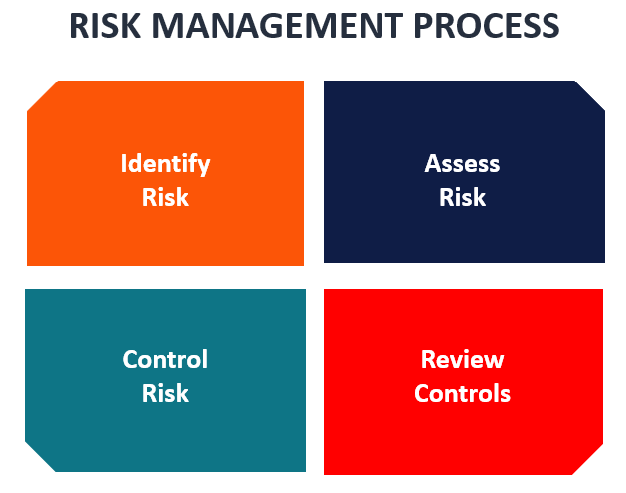

Slide 12
PRINCIPLES USED FROM POM
Here we consider from the principles of management from unit-2 :planning
Perception of opportunities
Establishing objectives
Consider the planning premisees
Identification of alternatives
Evaluation of alternatives
Choice of alternative plans
Formulating of supporting plans
Establishing sequence of activity

Slide 13
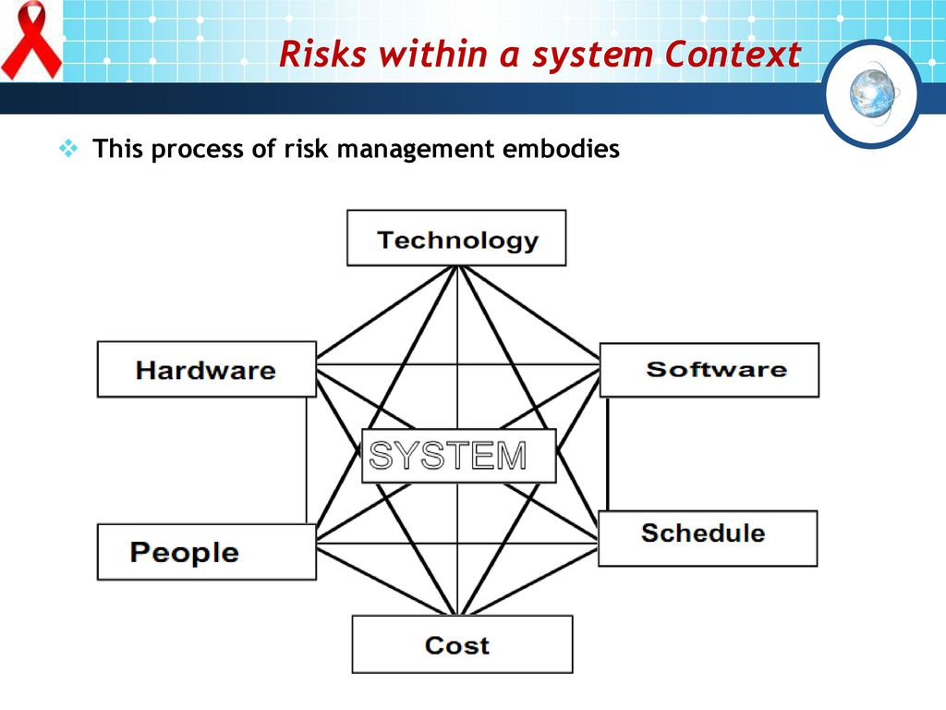
RISK MANAGEMENT EMBODIES

Slide 14
Principles of Risk Management
Global Perspective: Larger system definitions, design and implementation is considered. The opportunity and the impact that the risk is going to have is looked. View software risks in the context of a system and the business problem planned to solve.
Forward Looking View: Looking at the possible uncertainties that might dragged. Possible solutions of the risks that might occur in the future are considered. Think about the risk which may occur in the future and create future plans for managing the future events.

Slide 15
Open Communication: This enables the free flow of the communication between the end users and the development team so that they can clarify the risks. Encourage all the stakeholders and users for suggesting risks at any time.
Integrated Management: Risk management is made an integral part of the project management during this phase. A consideration of risk should be integrated into the software process.
Continuous Process: Risks are tracked continuously throughout the risk management paradigm during this phase. Modify the identified risk than the more information is known and add new risks as better insight is achieved

Slide 16
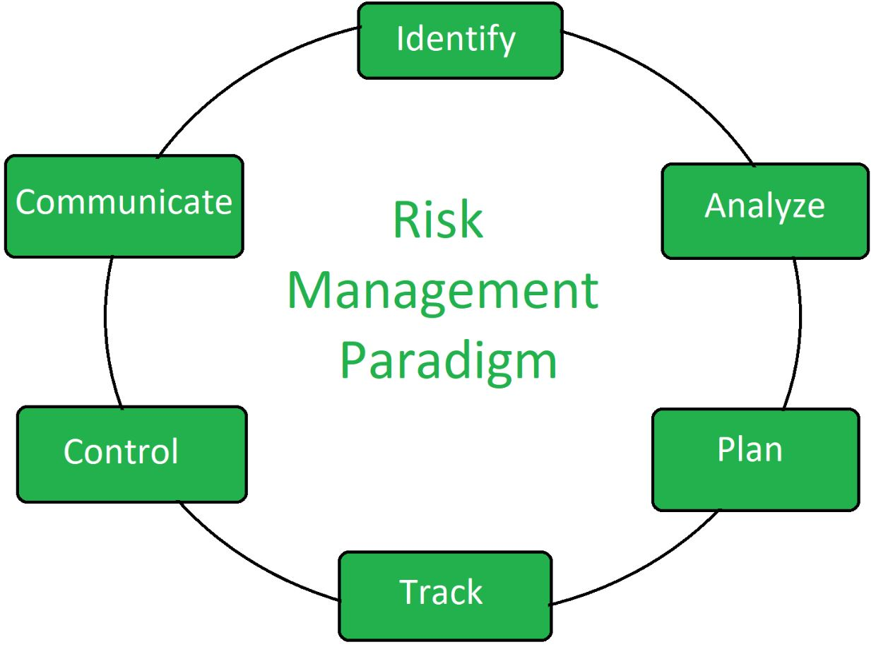
Risk Management Paradigm

Slide 17
Identify: Risks are identified before major problem is created. If the risks are identified before they create a major problem then there might not be more difficulty in controlling the risks.
Analyze: Deep analysis of nature, behavior and type of risk and collect information about it. It is required for the purpose of the determination of the knowledge about the risk.
Plan: Convert the plan into actions and implementation. This phase includes the actions and implementation of the planning that was done before. After the risk detection plans are made and executed.

Slide 18
Track: Necessary actions are monitored. Necessary action means the required work for the removal and minimization of the risk detected.
Control: Correct the deviation and make necessary changes. Put the right thing in the right place and the required field will changed according to the changes required.
Communicate: Discussion about the current risks and the future risks and their management. Make a productive discussion between the developer and tester on the risks found in the software.

Slide 19


LITERATURE REVIEW
Kevin MacG. Adams ,Old Dominion University (2007)
C. Ariel Pinto, Old Dominion University(2011)

Slide 20
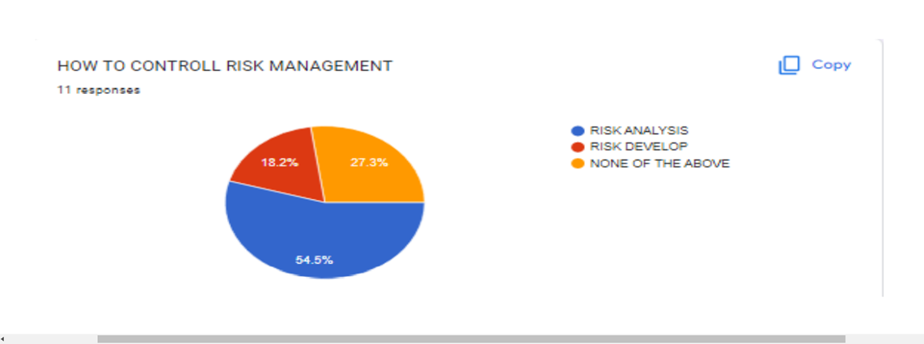
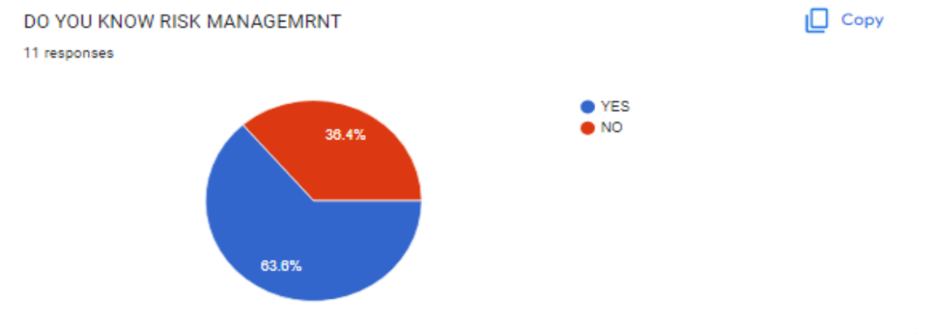
GOOGLE SURVEY

Slide 21
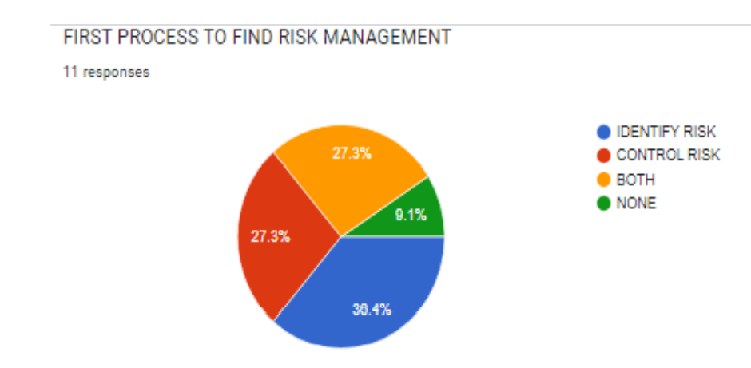
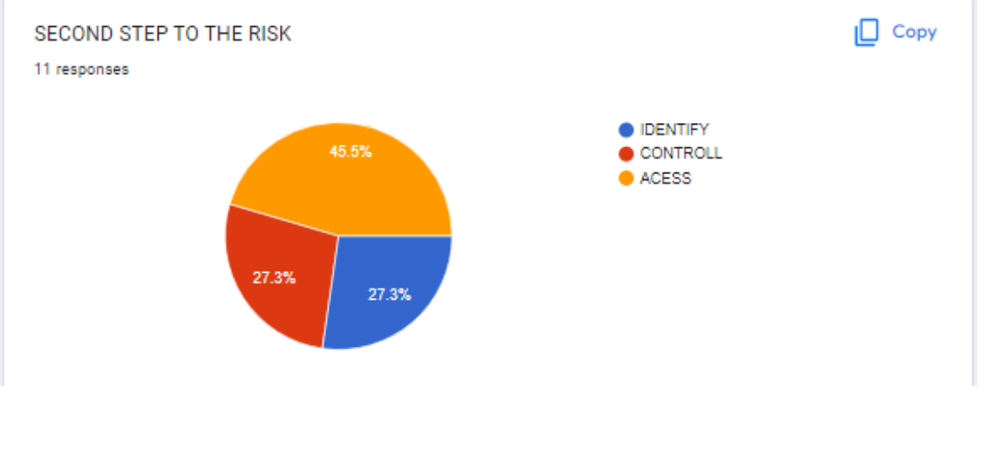

Slide 22

SUGGESTIONS OF RISK MANAGEMENT
unproven technologies
User and functional requirements
Application and system architecture
Performance
Organizational

Slide 23
CONCLUSION OF RISK MANAGEMENT
Risk management is an important process that managers should maintain in an organization.
It is inevitable to have risks and managers should have better strategies to deal with risks.
The long-term survival of an organization depends on the ability to manage risks.

Slide 24
REFERENCESES
Kutlu A. Can, Ekmekçioglu M., Fuzzy failure modes and effects analysis by using fuzzy TOPSIS-based fuzzy AHP, Expert Systems with Applications (39), 61–67, 2012
Fekete A., Safety and security target levels: Opportunities and challenges for risk management and risk communication, International Journal of Disaster Risk Reduction (2) 67–76, 2012
KarimiAzari A., Mousavi N., Mousavi F., Hosseini S., Risk assessment model selection in construction industry, Expert Systems with Applications (38), 9105–9111, 2011
Xanthopoulos A., Vlachos D., Lakovou E., Optimal newsvendor policies for dualsourcing supply chains:
A disruption risk management framework, Computers and Operations Research (39), 350–357, 2012

Slide 25


